Slide 1


LOAN PREDICTION APPROVAL SYSTEM WITH
WEB APPLICATION
(MINI PROJECT – CS8611)
BATCH NO : 09
• 312019104025 – KARTHIKEYAN P
• 312019104053 – RAJKIRAN S S

Slide 2

OBJECTIVE
Loan process verify will take more than 30 days in order to check whether the customer will be eligible for loan or not for manual verification.
Machine Learning helps to build automated systems that can learn by themselves.
It will reduce the time to check loan prediction.
It will increase the performance of the employee.

Slide 3

ABSTRACT
Using Machine Learning ,we can able to make prediction easily.
Collecting Customer data set, as .csv file
Analysis of data based on the dataset.
Using Random Forest Algorithm to predict the data of the customer to check for eligibility.
Using Flask framework and Jupyter notebook to display the result.

Slide 4

SYSTEM REQUIREMENT
HARDWARE REQUIREMENTS :
Processor : I3 8th gen processor
(or) Ryzen 2000 above
Graphic Card : 3GB Graphics card
Minimum RAM : 4GB Ram
Minimum Hard Disk : 512GB
SOFTWARE REQUIREMENTS :
Operating System : Windows / Linux
Simulation Tool : Anaconda with Jupyter Notebook
LANGUAGES USED :
Backend : Flask framework (Python)
Frontend : HTML, CSS, Bootstrap

Slide 5
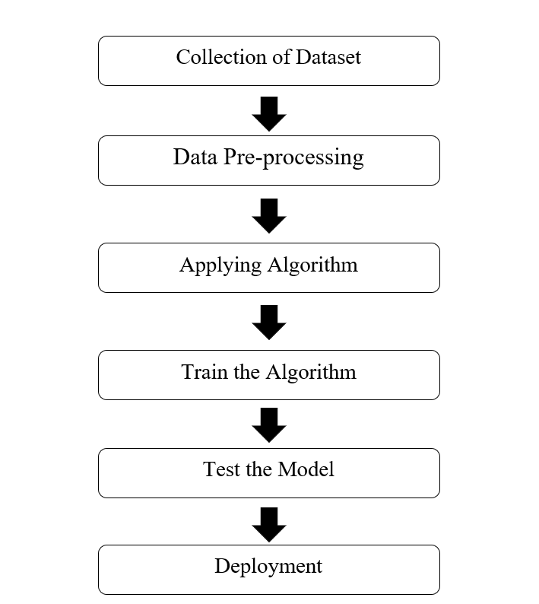
OVERALL ARCHITECTURE

Slide 6
EXISTING SYSTEM
Banks need to analyze for the person who applies for the loan will eligible for the loan or not.
Sometimes it happens that customer has provided partial data to the bank, in this case person may get the loan without proper verification and bank may end up with loss.
Bankers cannot analyze the huge amounts of data manually it may become a big headache to check whether a person will eligible to its loan or not.
It is very much necessary to know the person getting loan is going in safe hand or not.
So, it is pretty much important to have an automated model which should predict the customer getting the loan will eligible for the loan or not.

Slide 7
DRAWBACKS
Bankers cannot analyze the huge amounts of data manually it may become a big headache to check whether a person will eligible to its loan or not.
It is very much necessary to know the person getting loan is going in safe hand or not. So, it is pretty much important to have a automated model which should predict the customer getting the loan will repay the loan or not.
PROPOSED SYSTEM
By using a Random Forest Classifier approach, the right customers to be targeted for granting loan can be easily detected by evaluating their likelihood of default on loan.
The model concludes that a bank should not only target the rich customers for granting loan, but it should assess the other attributes of a customer as well which play a very important part in credit granting decisions and predicting the loan defaulters.

Slide 8
LITERATURE REVIEW
AUTHOR | ALGORITHM | ADVANTAGES | DISADVANTAGES
Niklean | Random Forest | Fast execution | Not implemented in Web application
Spidy | Decision Tree Classifier | Graph and Charts Representation | Execution is slow
George louriz | Logistic Regression | Implemented in Web application | Data are very limited

Slide 9
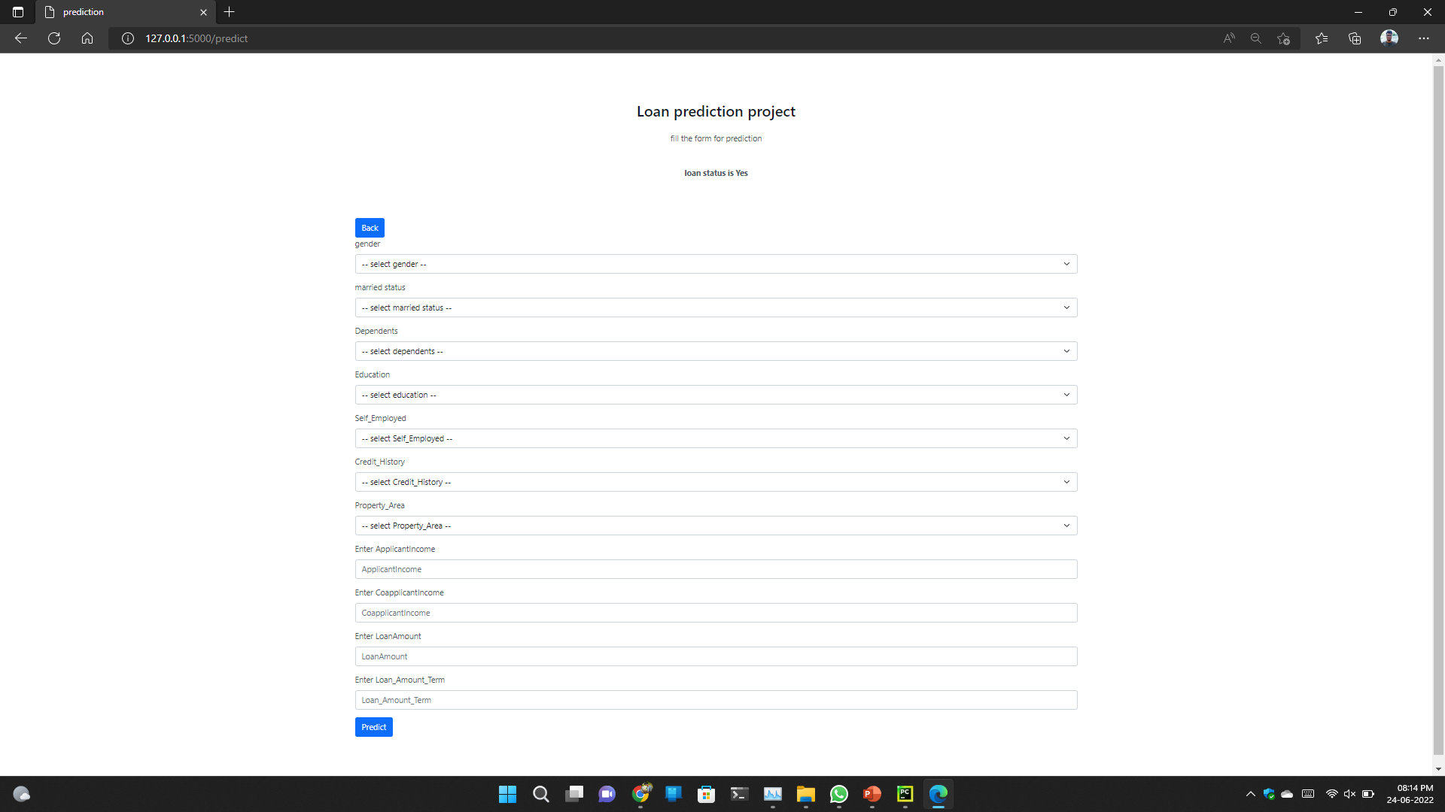
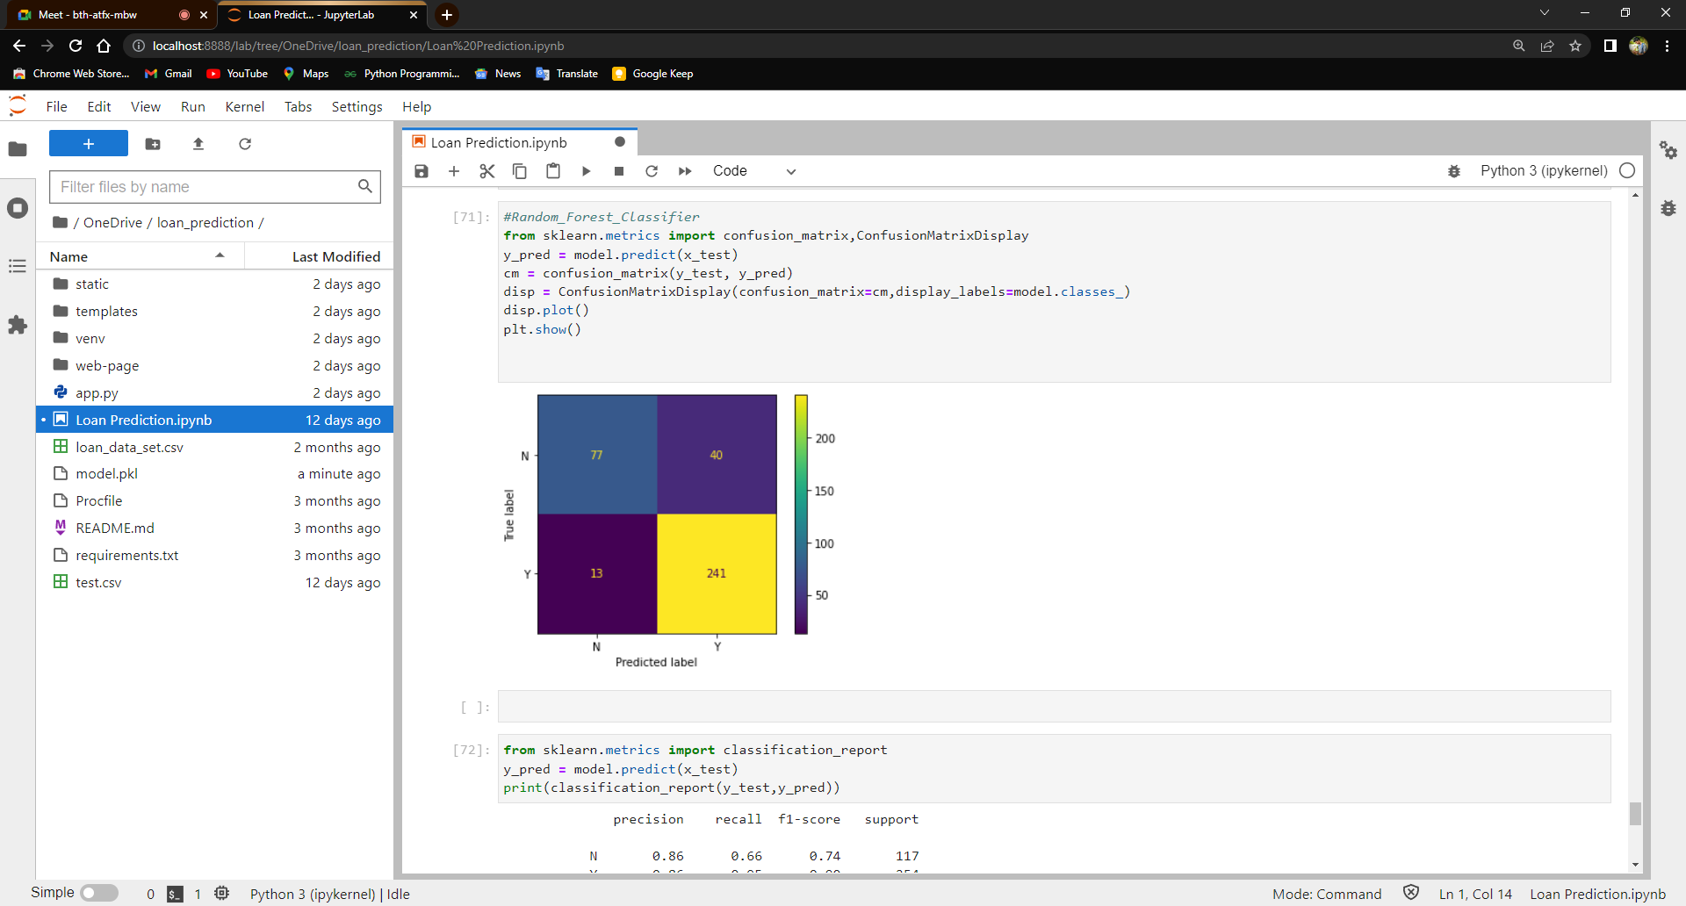
RESULT AND DISCUSSION

Slide 10
CONCLUSION
After this work, we are able to conclude that Random Forest Classifier version is extraordinary efficient and gives a higher end result.
We have developed a model which can easily predict that the person will repay its loan or not. we can see our model has reduced the efforts of bankers.
Machine learning has helped a lot in developing this model which gives precise results.

Slide 11
REFERENCES
[1] Dataset Source, https://www.kaggle.com
[2] Scikit Learn – scikitlearn.org
[3] https://gist.github.com/UpasanaYadav/1ea9051c849c4331afdc3f9818068022
[4] https://github.com/ASHOKKUMAR-K/Machine-LearningProjects/tree/master/02.Loan_Status_Prediction [5] https://www.youtube.com/watch?v=QIUxPv5PJOY (Computer Science)

Slide 12
Thank you

